Slide 1

Consumer Decision-Making Analysis in R
Reproducible, Collaborative, and AI-Aware Workflows

Slide 2
Overview
Structure of the workshop
Day 1: The scaffold
Day 2: R and data analysis
Day 3: Producing a report + Supercharge
Notes:
Main message: Over the next three days, we will build one reproducible research project from the ground up.
Speaker note: Today is not about becoming an R expert. Today is about understanding the set-up and structure: what R is, what RStudio does, how projects are structured, why GitHub matters, and how to avoid the most common traps.

Slide 3
The three-day roadmap
Day 1: Scaffold
Day 2: Analyse
Day 3: Publish
R
Rstudio
Git/GitHub basics
Folders
Data protection
Quarto
Base R
Import
Clean
Transform
Visualise
Describe
Model
Moderate / mediate
Collaborate
Export tables and figures
Write methods
Write results
Static/ Annotated/ interactive report
AI-use statement
Reproducibility check
Notes:
Speaker note: Everything today prepares the ground for the analysis and reporting work later. If the scaffolding is clear, the analysis becomes much easier to understand and debug.
Without scaffolding: “Where is my file?” “Which script did I run?” “Which version is correct?” “Why does it work on your laptop but not mine?” “Can I safely share this?”
With scaffolding: Files have a place. Scripts have an order. Outputs can be recreated. Changes are documented. Collaboration becomes possible.

Slide 4
Day 2
R & Data Analysis
The How

Slide 5
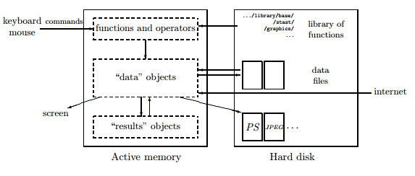

Slide 6
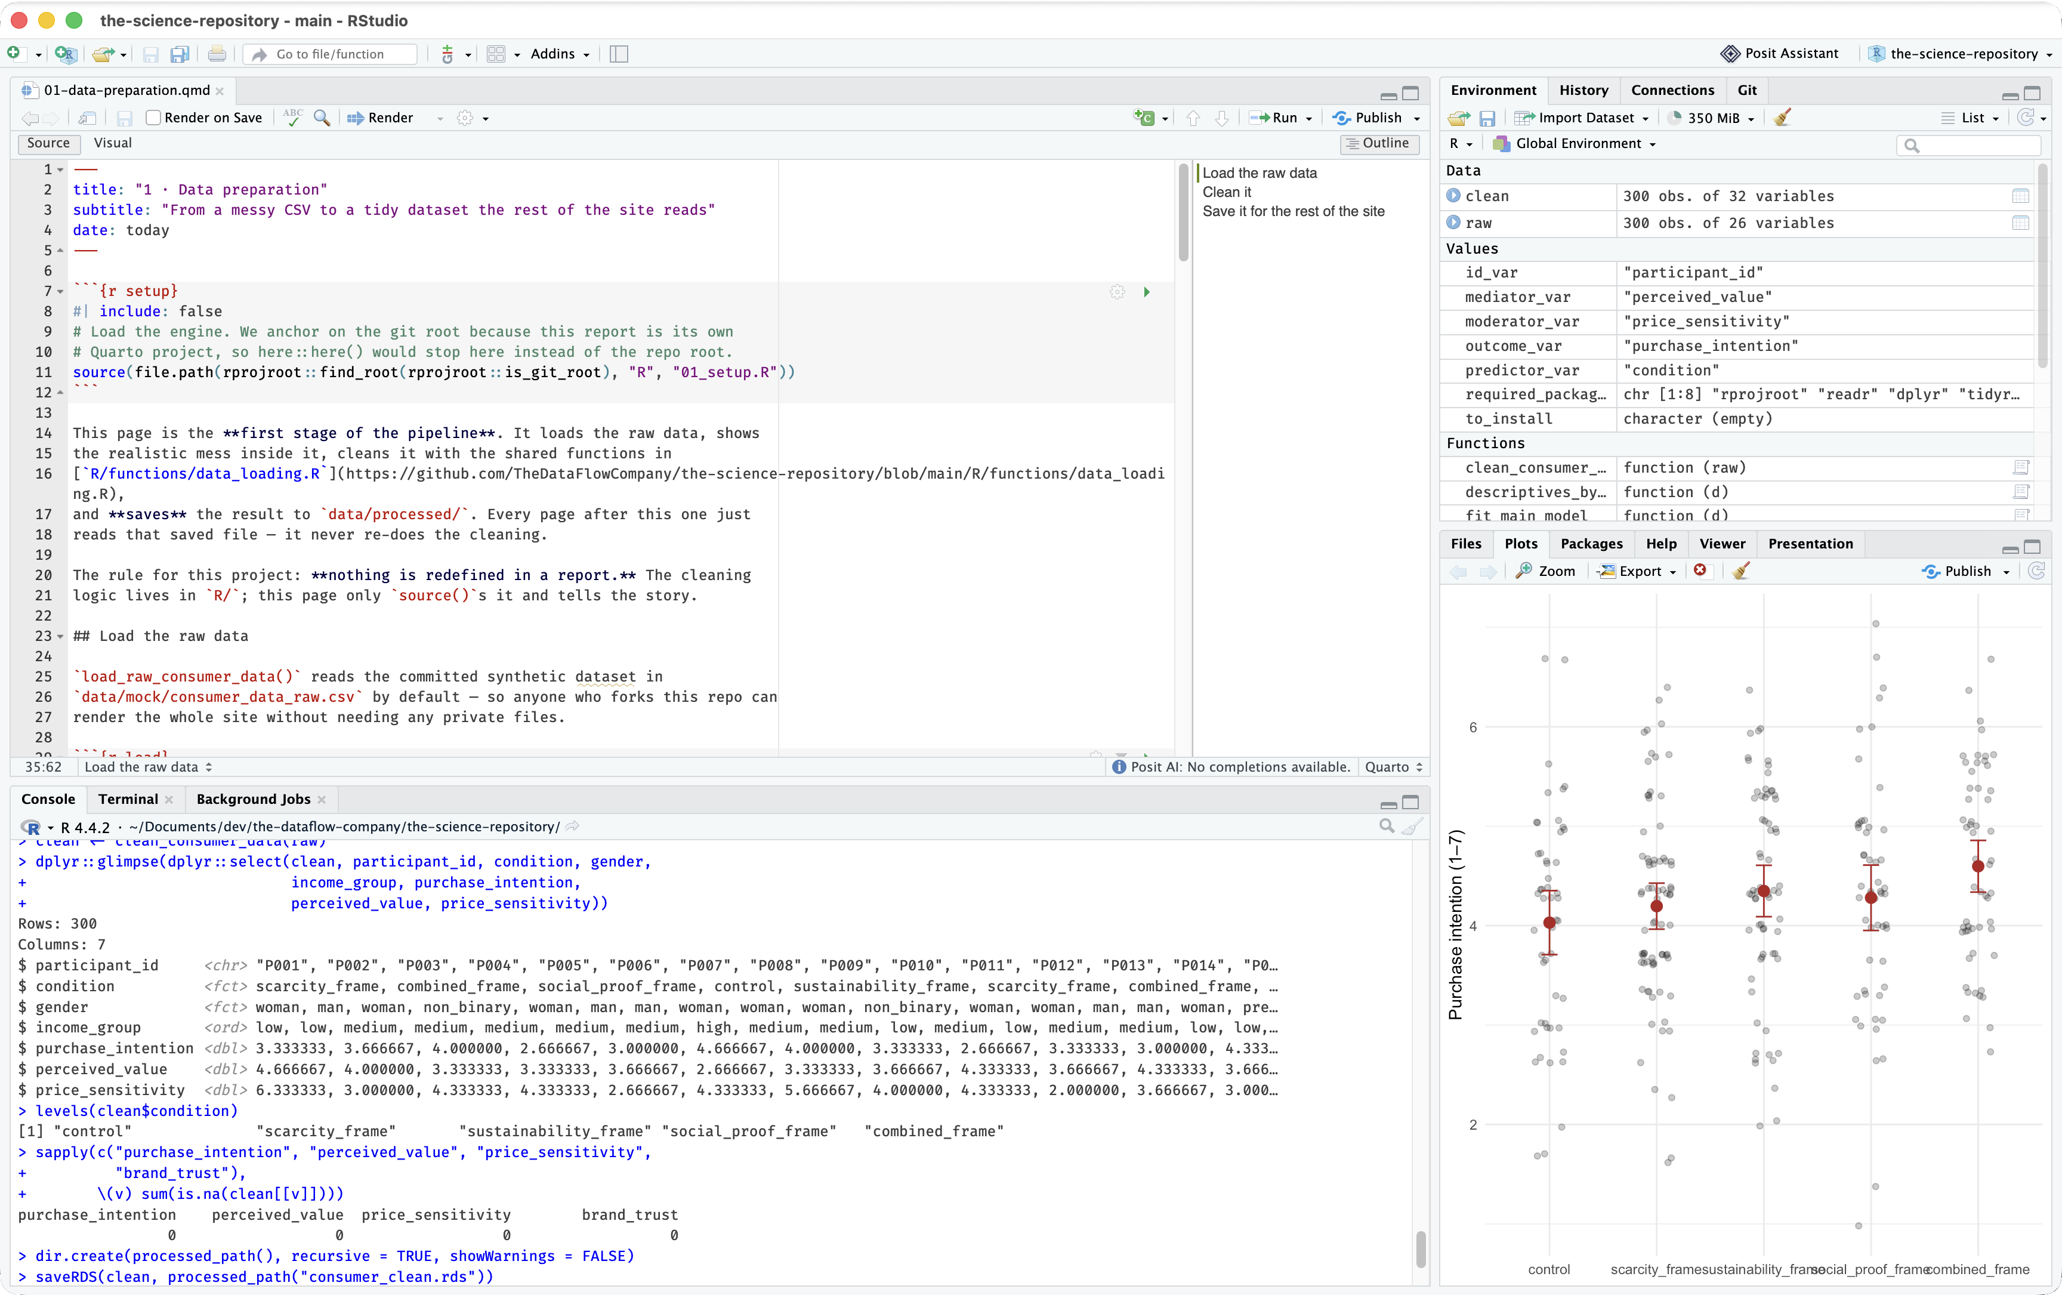
Source
where you write and save scripts
Environment
the objects in memory
Files/Plots/
Packages/Help
manage files, see figures, read docs
Console
where R runs R commands
Notes:
They are two separate installs. We install both. We are *not* learning R syntax today — that's Day 2. Today we just need it working.

Slide 7
Git/GitHub
see your changed and history
R project setup
your .Rproj settings
R Packages
your packages
Terminal
computer's command line, `quarto render` command
Notes:
They are two separate installs. We install both. We are *not* learning R syntax today — that's Day 2. Today we just need it working.

Slide 8
Quarto = prose + code → polished output
A .qmd file mixes:
- text (Markdown)
- R code chunks
- the results those chunks produce (tables, figures, numbers)
Quarto runs the code and weaves results into the finished document.
Why Quarto (and not R Markdown)? Quarto is R Markdown's successor:
- one engine for R, Python, and Julia (not R-only)
- one source → HTML, PDF, Word, slides, whole websites
- actively developed, batteries included (citations, cross-references)
Notes:
Quarto is the "Publisher" box — the cook that follows the recipe. The key idea: your figures and tables are *not* pasted in — they're generated when the document renders, straight from the `R/` engine. No copy-paste, no stale numbers. On the "why Quarto": if people know R Markdown, Quarto is the same idea grown up — one tool for many languages and many output formats, still free and open.

Slide 9
Day 3
The Report
Efficient Ins and Outs

